Slide 1

PRACTICAL
OBJECT-ORIENTED
DESIGN WITH UML
2e
Chapter 13:
Implementation Strategies

Slide 2
Implementation
The transition from UML models to Java code is mostly straightforward
Some features don’t map directly into code
  associations
  statecharts
A systematic approach should be taken to implementing these features

Slide 3
Implementing Associations
Associations describe properties of links
  a link gives one object access to another
  and enables message passing
References share these properties
  so associations can be implemented with reference data members

Slide 4
Issues with Associations
References support only one direction of navigation
  it is often worth trying to restrict navigation to make implementation easier
References should not be manipulated explicitly by other classes
  give one class the responsibility for maintaining an association
  other classes gain access through an interface

Slide 5

Optional Associations
A major distinction between associations is their multiplicity
Reference variables can hold
  a reference to another object
  or the null reference
So the ‘default’ multiplicity is ‘0..1’

Slide 6
Defining the Association
The association is defined by a field in the ‘Account’ class holding a reference to an instance of the ‘DebitCard’ class
  public class Account
  {
  private DebitCard theCard ;
  …
  }

Slide 7
Maintaining the Association
Obviously the ‘Account’ class is responsible for maintaining this association
  Add methods to perform whatever operations are required, eg:
  public DebitCard getCard() {
  return theCard ;
  }

Slide 8
Mutable Associations
Defined like this, the association is mutable
  the card linked to an account can be changed
  we should provide a method to do this
  public void setCard(DebitCard card) {
  theCard = card ;
  }

Slide 9
Immutable Associations
Some associations are immutable
  once assigned, a link must not be altered
  we have to check this explicitly, eg
  public void setCard(DebitCard card) {
    if (theCard != null) {
    // throw ImmutableAssociationError
    }
    theCard = card ;
    }

Slide 10

Multiplicity ‘One-to-one’
Suppose every account has exactly one guarantor
We must not allow null references to be stored in the ‘Account’ class
  this must be checked explicitly in code

Slide 11
Implementing One-to-one
Check that a link is provided in constructors
    public Account(Guarantor g) {
    if (g == null) {
    // throw NullLinkError
    }
    theGuarantor = g ;
    }
If the association is mutable, perform a similar check in ‘setGuarantor’

Slide 12

Multiplicity ‘Many’
Some associations require more than one link to be stored
A data structure like vectors can be used to store many references
  more specific multiplicities need to be checked explicitly in the code

Slide 13
Implementing ‘Many’
  public class Manager
  {
  private Vector theAccounts ;
  public void addAccount(Account acc) {
  theAccounts.addElement(acc) ;
  }
  // other methods as required
  }

Slide 14
Bidirectional Implementation
Some associations need to be navigated in both directions
  because references are unidirectional, it will take two references to implement a link
  the association can be implemented by including a suitable field in each of the associated classes

Slide 15
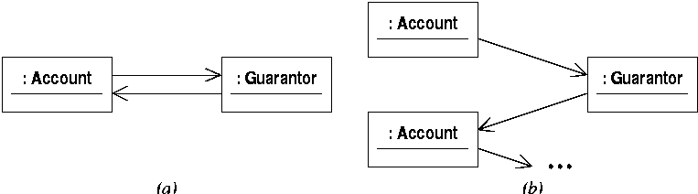
Referential Integrity
It is necessary to ensure that the two references are ‘inverses’ of each other
(b) violates referential integrity

Slide 16

A Bidirectional Association
A bidirectional association can be treated as a pair of simpler associations
  eg a mutable, optional association from ‘Account’ to ‘DebitCard’
  and an immutable association in the other direction
  combine the two separate implementations

Slide 17
Creating Bidirectional Links
This approach makes it tricky to create new links
    Account acc1 = new Account() ;
    DebitCard card1 = new DebitCard(acc1) ;
    acc1.setCard(card1) ;
It would be easy to get this wrong, eg
    DebitCard card1 = new DebitCard(acc1) ;
    acc2.setCard(card1) ;
This violates referential integrity

Slide 18
Assigning Responsibility
Make one of the classes responsible for maintaining the association
  probably the ‘Account’ class in this case
  when a card is added, it calls an operation in ‘DebitCard’ to set up the opposite link
  limit the manipulations that other classes can perform on debit cards
  eg don’t make the constructor public

Slide 19
The Account Class
  public class Account
  {
  private DebitCard theCard ;
  public void addCard() {
  theCard = new DebitCard(this) ;
  }
  }

Slide 20
The DebitCard Class
  public class DebitCard
  {
  private Account theAccount ;
  DebitCard(Account a) {
  theAccount = a ;
  }
  }

Slide 21

One-to-many Associations
These raise no new problems
  ‘Customer’ holds a vector of references
  ‘Account’ holds a single non-null reference
  ‘Customer’, say, responsible for maintaining links

Slide 22

Many-to-many Associations
These introduce no new issues of principle
Can reify the association
  make the new class responsible for maintaining links

Slide 23

Joint Creation of Objects
The constructor for each of these classes should take an instance of the other
  Java doesn’t permit the simultaneous creation of objects that this implies
  must create one of the objects with a default constructor

Slide 24

Qualified Associations
The purpose of a qualifier is often to provide efficient access to linked objects
  for example, we want to access accounts given only the account number
  we want to avoid a linear search through all accounts

Slide 25
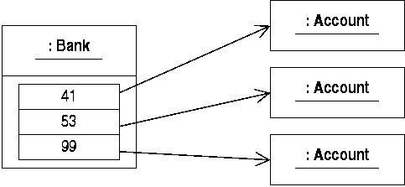
Implementing Qualifiers
The run-time structure we need involves some kind of index to accounts

Slide 26
Using a Hash Table
  public class Bank
  {
  private Hashtable theAccounts ;
  public void addAccount(Account a) {
  theAccounts.put(
  new Integer(a.getNumber(), a) ;
  }
  // and so on
  }

Slide 27
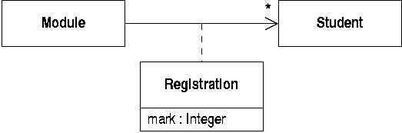
Association Classes
The association cannot be implemented with a single reference field
  data needs to be associated with the reference

Slide 28

Implementing Association Classes
A common strategy is to replace the association class with
  a class to hold the specified data
  and a pair of associations

Slide 29
The Registration Class
The ‘Registration’ class holds a mark and a link to a student
    class Registration
    {
    Registration(Student st) {
    student = st ; mark = 0 ;
    }
    private Student student ;
    private int mark ;
    }

Slide 30
The Module Class
To add a link, create a new instance
    public class Module
    {
    private Vector registrations ;
    public void enrol(Student st) {
    registrations.addElement(
    new Registration(st)) ;
    }
    }

Slide 31
Implementing Constraints
Constraints need to be checked at run-time
  Class invariants need to be checked after operations that can change state: useful for debugging purposes
  Preconditions should be checked when operations are called: useful security in live code
  Postconditions need to be checked at the end of a method body: useful in debugging

Slide 32
The SavingsAccount Class
A typical precondition check:
    public class SavingsAccount
    {
    public void withdraw(double amt) {
    if (amt >= balance) {
    // throw PreconditionUnsatisfied
    }
    balance -= amt ;
    }
    }

Slide 33
Implementing Statecharts
Interaction diagrams give details of how particular operations should be implemented
If a statechart for a class exists
  it gives an overall specification of the class behaviour
  it can be used to structure the implementation of the operations in a systematic way

Slide 34
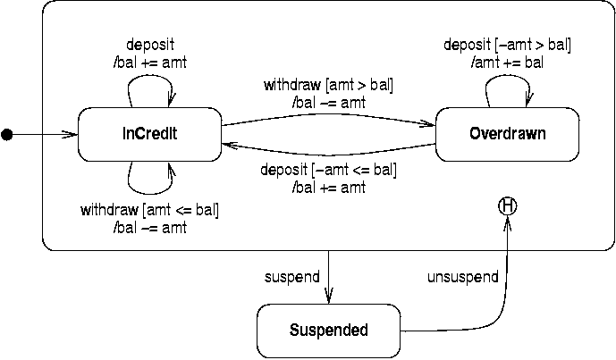
A Statechart for Accounts

Slide 35
Implementing States
We need to define states and record an object’s current state
    public class Account {
    private final int InCredit = 0 ;
    private final int OverDrawn = 1 ;
    private final int Suspended = 2 ;
    private int state ;
    // …
    }

Slide 36
Initial State
The initial state specifies what state the object is in when it is created
  implement this in the constructor
    public Account() {
    state = InCredit ;
    }

Slide 37
Implementing Operations
Operations may have state-dependent behaviour
  implement using a switch statement
  one case for each state
  code performs state-specific actions

Slide 38
Implementing Withdrawal
public void withdraw(double amt) {
switch (State) {
case InCredit:
    if (amt > bal) { state = Overdrawn; }
    bal -= amt ;
    break ;
  case Overdrawn: case Suspended:
    break ;
  }
}

Slide 39
Composite States
Simply group together simple states
    public void suspend() {
    switch (state) {
    case InCredit: case Overdrawn:
    state = Suspended ;
    break ;
    case Suspended:
    break ;
    }
    }

Slide 40
History State
Store when leaving composite state
Reinstate when unsuspending
    private int historyState ;
    public void unsuspend() {
    switch (state) {
    case Suspended:
    state = historyState ;
    break ;
    // other cases
    }
    }

Slide 41
Reverse Engineering
Reverse the rules for implementation
Produce UML documentation from program code
Useful when undocumented code is to be modified or maintained
  lost documentation
  legacy systems

Slide 42
A Track Class
Part of a simple audio application
    abstract class Track
    {
    protected String title ;
    protected int duration ;
    Track(String t, int d) {
    title = t ;
    duration = d ;
    }
    abstract void play() ;
    }

Slide 43
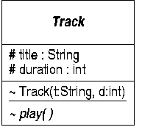
The Track Class in UML
Everything except the constructor body can be represented in UML

Slide 44
Subclasses of Track
Subclasses of ‘Track’ define particular file formats
    class mp3 extends Track
    {
    mp3(String t, int d) { super(t, d); }
    void play() {
    // implementation omitted
    }
    }

Slide 45
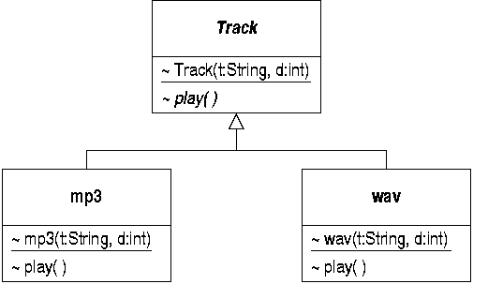
Inheritance in UML
Subclasses are specializations of ‘Track’

Slide 46
A Playlist class
A playlist maintains a list of tracks and can play them
    public class Playlist
    {
    private Vector tracks ;
    public void add(Track t) { … } ;
    public void play() {
    // Play each track in turn
    }
    }

Slide 47
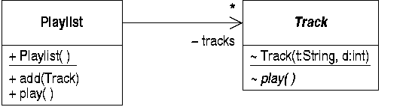
Modelling References
An association would be implemented using a vector of references
So the ‘tracks’ field is best modelled as an association, not an attribute

Slide 48
Documenting Behaviour
Client code will create objects and send messages
    public static voic main(String[] args) {
    Playlist list = new Playlist() ;
    list.add(new mp3(“Who let…”, 193) ;
    list.add(new wav(“Meowth…”, 253) ;
    list.add(new mp3(“Thunderball”, 480) ;
    list.play() ;
    }

Slide 49
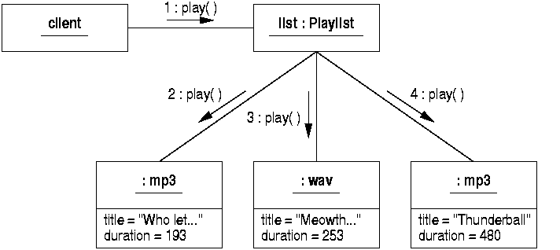
A Collaboration Diagram
Run-time behaviour can be documented on a suitable collaboration

